Slide 1

JUnit Lambda -> JUnit 5 Java Unit Test Framework
INPE CAP 385 Desenvolvimento de Frameworks
2º Período / 2016
Luiz Wagner Tavares Nascimento
nascimentolwtn@gmail.com

Slide 2
JUnit 5 Test Framework - Roteiro
Parte 1:
Introdução
Setup
Ciclo de Vida
Exemplos
Parte 2:
Arquitetura do Framework
Pontos de Extensão (@IntegrationTest, @Benchmark)
Condições / Injeções
Testes Dinâmicos

Slide 3
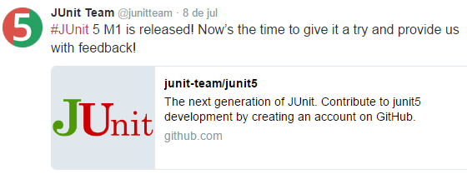
Introdução
JUnit Lambda
Out/Nov 2015: Java 8 para testar código Java 8
JUnit 5
Fev 2016: Alpha Release (5.0.0-ALPHA)
Jul 2016: Milestone 1 (5.0.0-M1)
Previsão de GA final de 2016

Slide 4

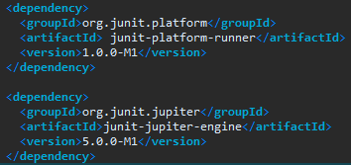
JUnit 5 - Setup
Código de Testes
Runner

Slide 5
JUnit 5 – Ciclo de Vida
@org.junit.jupiter.api.Test;
@AfterAll; @AfterEach;
@BeforeAll; @BeforeEach;
@Disabled;
Visibilidade default
assumeTrue; assumeFalse; assertAll;
@Nested; @DisplayName;
@Tag
API Assertivas - Hamcrest and AssertJ

Slide 6
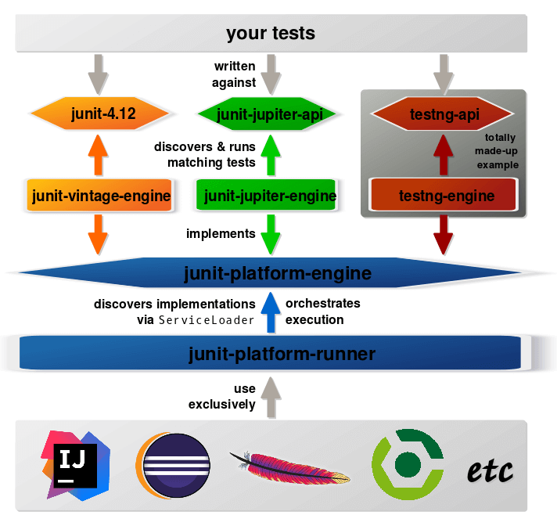
Arquitetura do Framework
JUnit 5 = JUnit Platform + JUnit Jupiter + JUnit Vintage

Slide 7
JUnit 5 Test Framework
Testar a funcionalidade e desempenho do código MATLAB
http://www.codeaffine.com/2016/02/18/junit-5-first-look/
JUnit 5 – A First Look at the Next Generation of Junit
In the beginning of February, the JUnit 5 (aka JUnit Lambda) team has published an alpha release. Since JUnit 4 is among the most used items in my toolbox I thought it might be worth to have a look at the next major release.

Slide 8
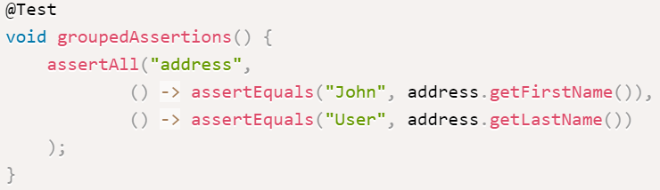
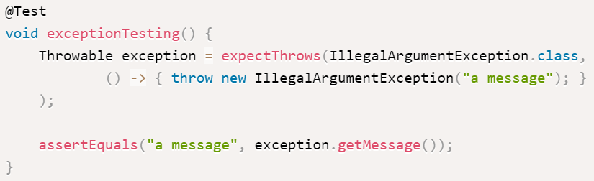
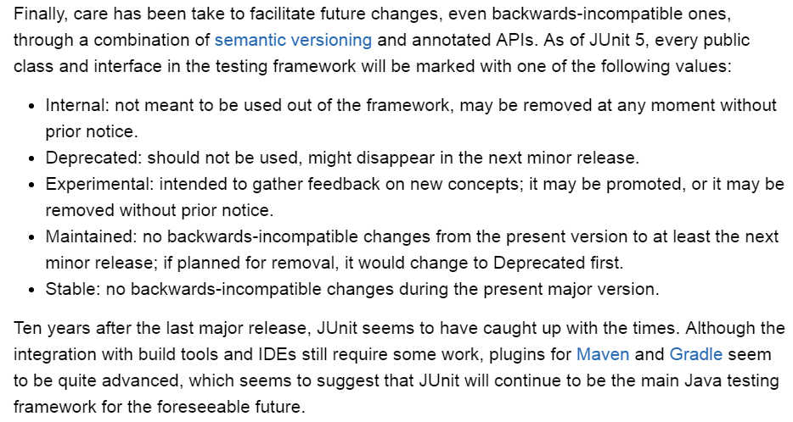
JUnit 5 Test Framework
https://www.infoq.com/news/2016/03/junit5-alpha

Slide 9
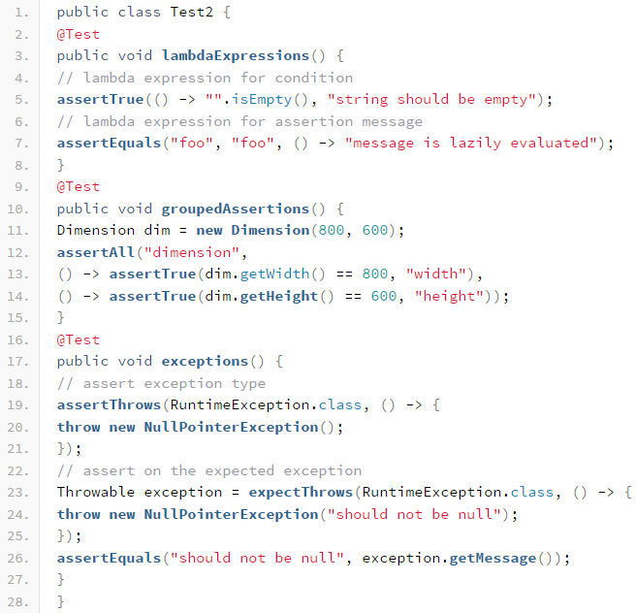
JUnit 5 Test Framework
http://blog.codefx.org/libraries/junit-5-setup/
Setup
Basics
Architecture
Extension Model
Conditions
Injection
Dynamic Tests
http://blog.codefx.org/design/architecture/junit-5-architecture/
http://blog.codefx.org/libraries/junit-5-basics/
http://blog.codefx.org/design/architecture/junit-5-extension-model/

Slide 10
JUnit 5 Test Framework
http://blog.so-geht-software.de/2016/02/whats-new-in-junit-5/
Assertions
Assumptions, tags and disabled tests
Extension model
Can I use Hamcrest Matchers or AssertJ with JUnit 5?
What’s next?
There is no roadmap on the project’s GitHub page. JUnit 5 is alpha now, feel free to test it and give your feedback. The team has built integration modules for Gradle and Maven Surefire. If you would like to run JUnit 5 tests in your IDE you can use the JUnit 4 Runner.

Slide 11
JUnit 5 Test Framework
https://dzone.com/articles/junit-5-basics
Test Lifecycle
@Test
Before and After
@Disabled
Assertions
Extended
Assumptions
'@Nested‘
@DisplayName

Slide 12
JUnit 5 Test Framework
http://radar.oreilly.com/2014/12/unit-testing-java-8-lambda-expressions-and-streams.html
Unit Testing Java 8 Lambda Expressions and Streams
Two approaches to testing lambdafied code.
Lambda expressions pose a slightly different challenge when unit testing code. Because they don’t have a name, it’s impossible to directly call them in your test code. You could choose to copy the body of the lambda expression into your test and then test that copy, but this approach has the unfortunate side effect of not actually testing the behavior of your implementation. If you change the implementation code, your test will still pass even though the implementation is performing a different task.

Slide 13
JUnit 5 Test Framework
http://blog.codeleak.pl/2014/07/junit-testing-exception-with-java-8-and-lambda-expressions.html
JUnit: testing exception with Java 8 and Lambda Expressions
In JUnit there are many ways of testing exceptions in test code, including try-catch idiom, JUnit @Rule, with catch-exception library. As of Java 8 we have another way of dealing with exceptions: with lambda expressions. In this short blog post I will demonstrate a simple example how one can utilize the power of Java 8 and lambda expressions to test exceptions in JUnit.

Slide 14

Apresentação do MATLAB xUnit Test Framework

Slide 15
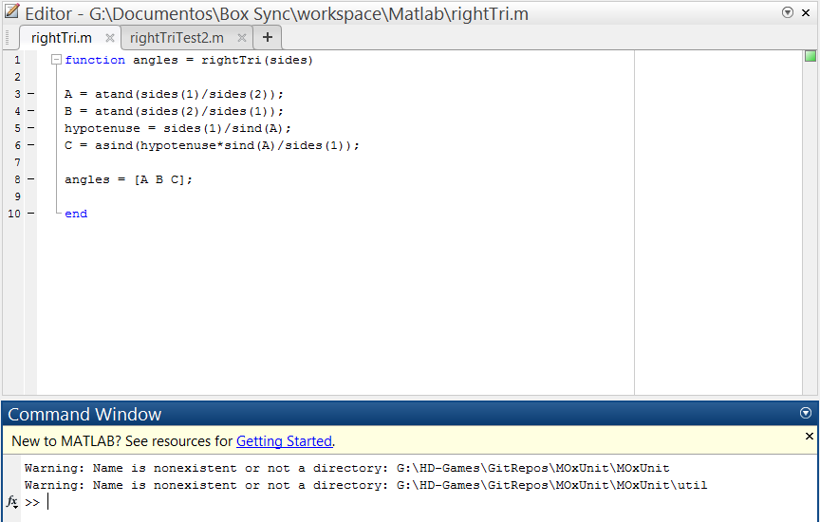
Exemplo - Função

Slide 16
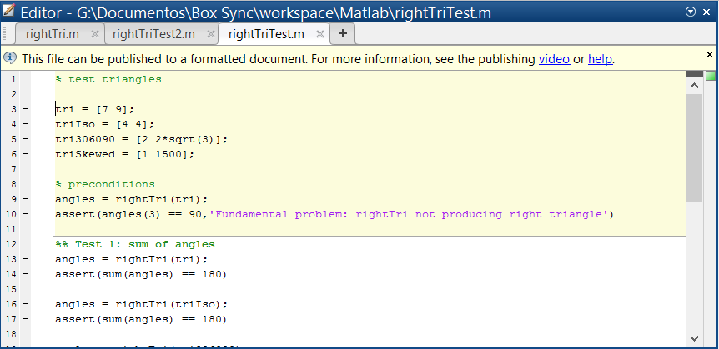
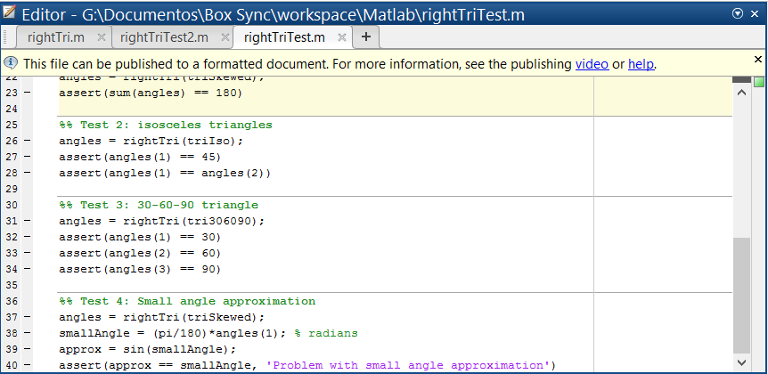
Exemplo – Função (Código Teste)

Slide 17
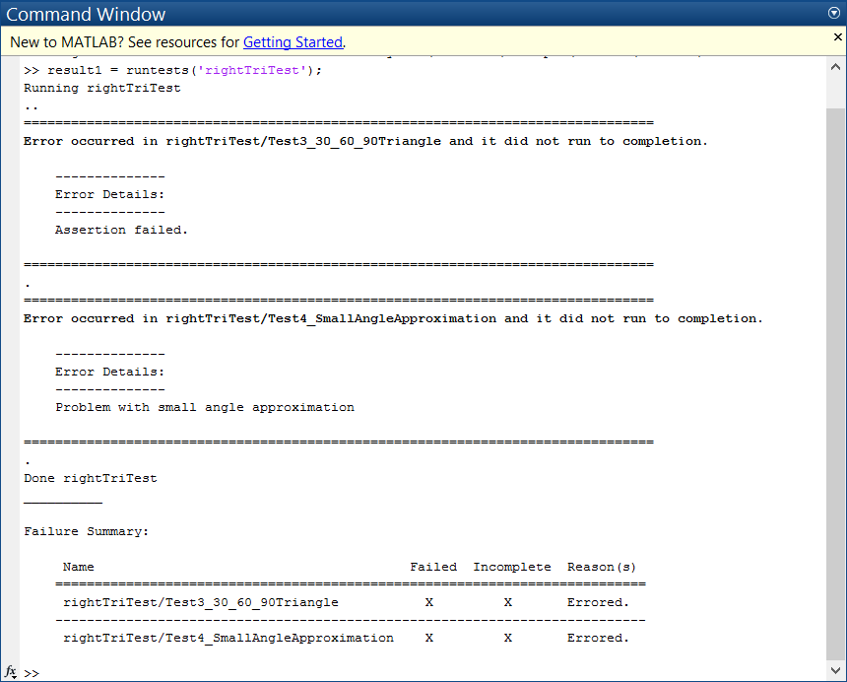
Exemplo – Função (Resultados)

Slide 18
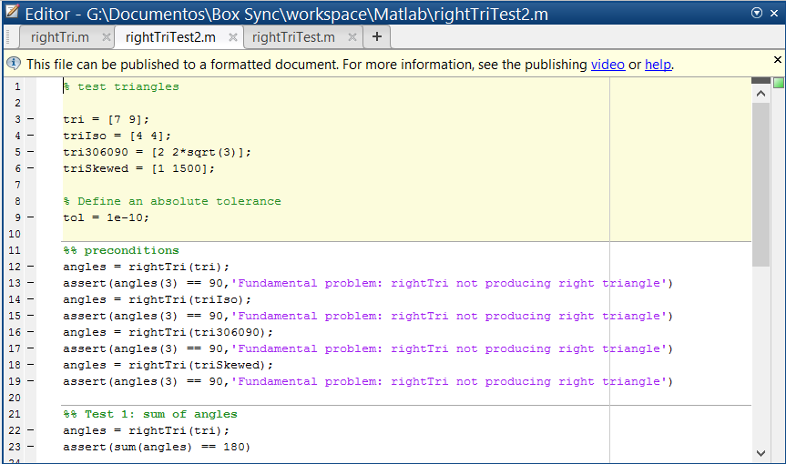
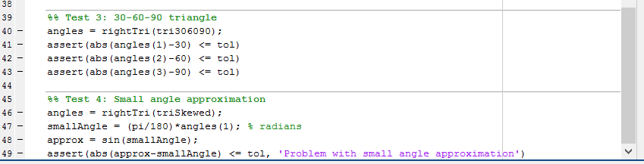
Exemplo – Função (Código Correção)

Slide 19
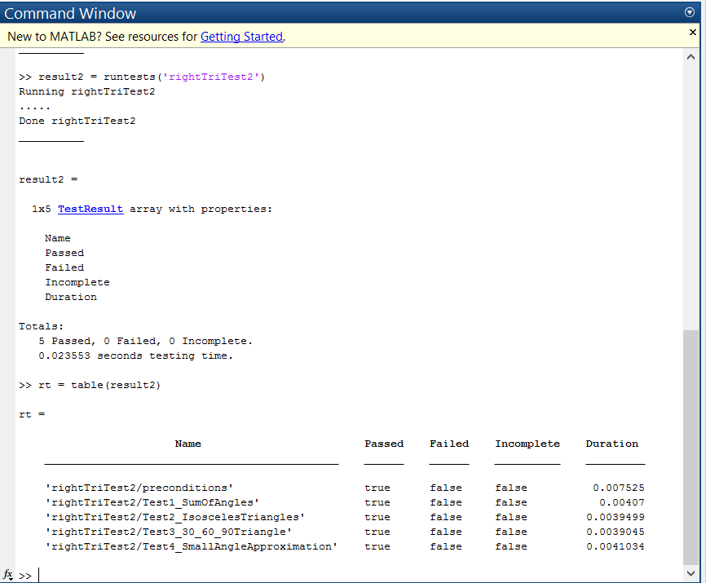
Exemplo – Função (Resultados Correção)

Slide 20
Considerações
Framework ?
runtests(‘test_suite’)
Assertivas / Instrumentação
Resultados tabelados
Desempenho
Extensões
TestRunner
Constraints
Tolerance
Fixtures

Slide 21
Java 8 Lambda Expressions Revision
http://blog.caelum.com.br/o-minimo-que-voce-deve-saber-de-java-8/
http://pt.stackoverflow.com/questions/269/quais-as-vantagens-das-express%C3%B5es-lambda-presentes-no-java-8
http://www.devmedia.com.br/como-usar-funcoes-lambda-em-java/32826
http://www.devmedia.com.br/novidades-do-java-8-do-lambda-ao-metaspace/29056
http://www.teclogica.com.br/blog/java-8-o-que-e-lambda/
https://rodrigouchoa.wordpress.com/2014/05/20/novidades-do-java-8-lambda-expressions/
http://blog.takipi.com/compilando-expressoes-lambda-scala-vs-java-8/

Slide 22
JUnit 5 Test Framework
http://stackoverflow.com/questions/28688047/unit-test-code-with-java-8-lambdas
http://stackoverflow.com/questions/34576710/how-to-test-lambda-functions
https://pythonconquerstheuniverse.wordpress.com/2011/08/29/lambda_tutorial/
http://www.coderanch.com/t/647426/Testing/approach-testing-lambda-expressions
Node.js https://pub.scotch.io/@richardhyatt/unit-testing-aws-lambda-functions-in-nodejs
Python

